Slide 1
Advance Structure Analysis
“Stiffness Matrix Method”
By: Asst. prof. Dr. Wissam D. Salman

Slide 2
Beam Element ***
There are three degree of freedom in each node; six degree of freedom in each element.

Slide 3
Then: stiffness matrix for beam element in local coordinate system:-
$${\left[k`\right]}^{e}=\left[\begin{matrix}\frac{AE}{L} & 0 & 0 & −\frac{AE}{L} & 0 & 0 \\ 0 & 12\frac{EI}{L^{3}} & 6\frac{EI}{L^{2}} & 0 & −12\frac{EI}{L^{3}} & 6\frac{EI}{L^{2}} \\ 0 & 6\frac{EI}{L^{2}} & 4\frac{EI}{L} & 0 & −6\frac{EI}{L^{2}} & 2\frac{EI}{L} \\ −\frac{AE}{L} & 0 & 0 & \frac{AE}{L} & 0 & 0 \\ 0 & −12\frac{EI}{L^{3}} & −6\frac{EI}{L^{2}} & 0 & 12\frac{EI}{L^{3}} & −6\frac{EI}{L^{2}} \\ 0 & 6\frac{EI}{L^{2}} & 2\frac{EI}{L} & 0 & −6\frac{EI}{L^{2}} & 4\frac{EI}{L}\end{matrix}\right]$$

Slide 4
In beam element with axial force only, single degree of freedom at each nodes; two degree of freedom in each element.
Stiffness matrix for beam element with axial force only:-
$${\left[k`\right]}^{e}=\left[\begin{matrix}\frac{AE}{L} & −\frac{AE}{L} \\ −\frac{AE}{L} & \frac{AE}{L}\end{matrix}\right]$$

Slide 5
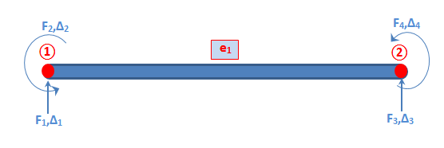
And: In beam element without axial force, there are two degree of freedom at each nodes; four degree of freedom in each element.
Stiffness matrix for beam element without axial force:-
$${\left[k`\right]}^{e}=\frac{EI}{L^{3}}\left[\begin{matrix}12 & 6L & −12 & 6L \\ 6L & 4L^{2} & −6L & 2L^{2} \\ −12 & −6L & 12 & −6L \\ 6L & 2L^{2} & −6L & 4L^{2}\end{matrix}\right]$$

Slide 6
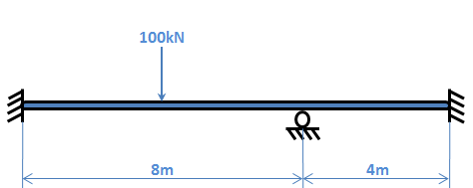
Example1: Analyse the structure shown in figure, use the stiffness matrix method. Neglect the axial force.

Slide 7
Solution:
Method1:-
From B.C. ∆₁ , ∆₂ , ∆₅ , ∆₇ , ∆₈ equal to zero
:. Unknown ∆₃ , ∆₄ & ∆₆

Slide 8
$${\left[k`\right]}^{e}=\frac{EI}{L^{3}}\left[\begin{matrix}12 & 6L & −12 & 6L \\ 6L & 4L^{2} & −6L & 2L^{2} \\ −12 & −6L & 12 & −6L \\ 6L & 2L^{2} & −6L & 4L^{2}\end{matrix}\right]$$
There are two methods:
Method1: Individual elements i.e [k] for element1, [k] for element2 & [k] for element3.
Method2: Direct to overall matrix.

Slide 9
$$\left[\begin{matrix}−100 \\ 0 \\ 0\end{matrix}\right]=\frac{EI}{L^{3}}\left[\begin{matrix}24 & 0 & 24 \\ 0 & 128 & 32 \\ 24 & 32 & 128\end{matrix}\right]\left[\begin{matrix}∆_{3} \\ ∆_{4} \\ ∆_{6}\end{matrix}\right]$$

Slide 10
$$\frac{EI}{L^{3}}[24∆_{3}+0∆_{4}+24∆_{6}=−100…………………①$$
$$\frac{EI}{L^{3}}[0∆_{3}+128∆_{4}+32∆_{6}=0………….….………②$$
$$\frac{EI}{L^{3}}[24∆_{3}+32∆_{4}+128∆_{6}=0…………....………③$$
Solving get:-
$$∆_{3}=\frac{−125}{24}\frac{L^{3}}{EI}=−5.2083 \frac{L^{3}}{EI}$$
$$∆_{4}=\frac{−25}{96}\frac{L^{3}}{EI}=−0.26042 \frac{L^{3}}{EI}$$
$$∆_{6}=\frac{25}{24}\frac{L^{3}}{EI}=1.0416 \frac{L^{3}}{EI}$$

Slide 11
Substitute in overall matrix get:-
F₁= 56.25 kN ↑
F₂= 116.67 kN.m
F₅= 68.75 kN ↑
F₇= -25 = 25 kN ↓
F₈= 33.33 kN.m
Now we can draw the shear force and bending moment diagram.
Answer

Slide 12
Method2:-
Solution the previous example by method2:
From B.C. ∆₁ , ∆₂ , ∆₃ , ∆₅ , ∆₆ equal to zero
:. Unknown ∆₄ only
There is a concentrated load at element1; using fix end moment to translate force.

Slide 13
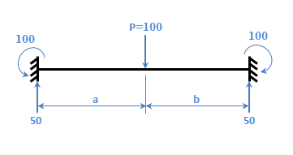
$$F.E.M=\frac{P.a.b^{2}}{L^{2}}$$
For a=b
$$F.E.M=\frac{P.L}{8}$$

Slide 14
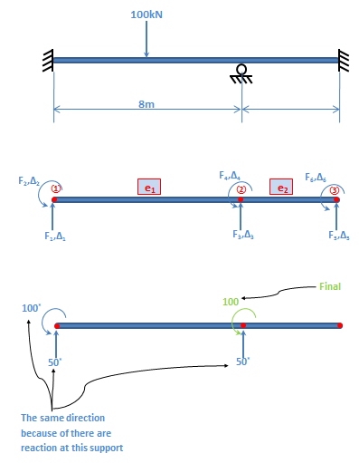
Answer

Slide 15
$${\left[k`\right]}^{e}=\frac{EI}{L^{3}}\left[\begin{matrix}12 & 6L & −12 & 6L \\ 6L & 4L^{2} & −6L & 2L^{2} \\ −12 & −6L & 12 & −6L \\ 6L & 2L^{2} & −6L & 4L^{2}\end{matrix}\right]$$
[F]=[k].[∆]

Slide 16
EI (1.5 ∆₄) = 100
:. $∆_{4}= \frac{66.667}{EI}$
Substitute get:
F₁= 6.25 + F* = 6.25 + 50 = 56.25 kN ↑
F₂= 16.67 + F* = 16.67 + 100 = 116.67 kN.m
F₃= 18.75 + F* = 18.75 + 50 = 68.75 kN ↑
F₇= -25 = 25 kN ↓
F₈= 33.33 kN.m
Answer

Slide 17
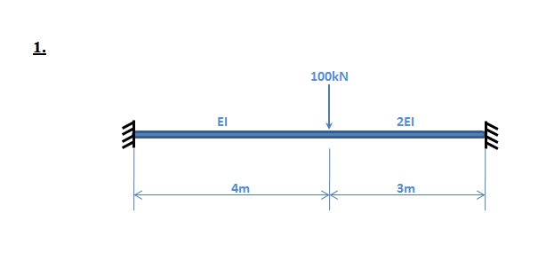
H.W: Use stiffness matrix method to draw shear force diagram and bending moment diagram (neglected axial force).

Slide 18
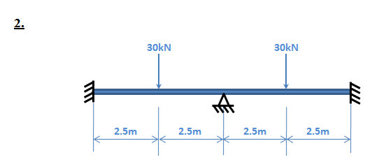

Slide 19
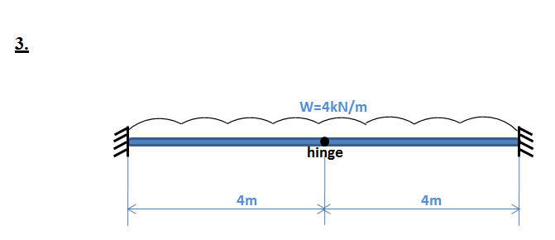

Slide 20
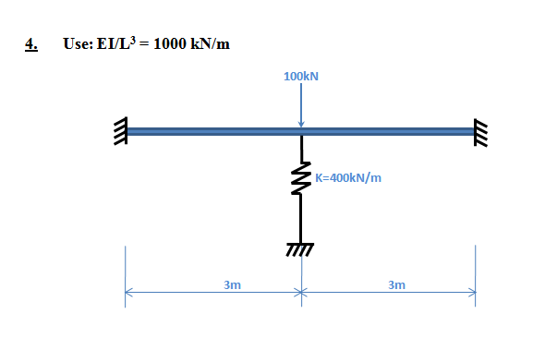

Slide 21
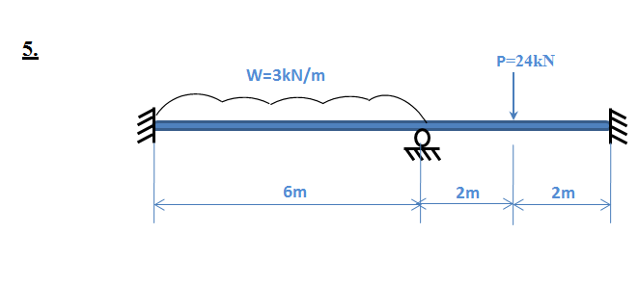

Slide 22
